Slide 1

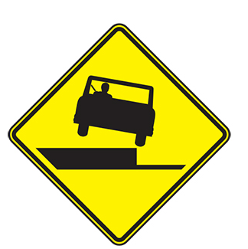
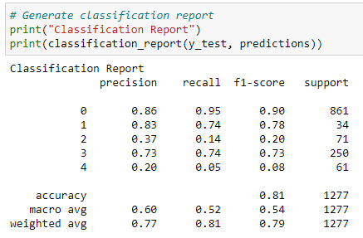
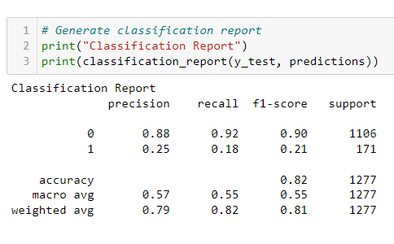
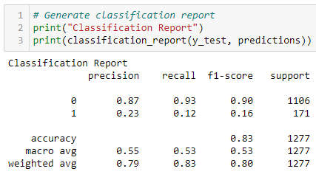
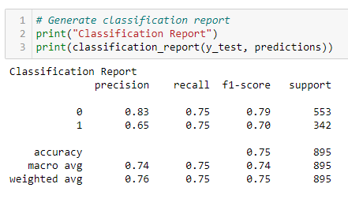
Machine Learning Steps Taken
Step
Step
Step
Step
Step
Run models with all data and injury type target
Target Accident Class
Refine Change encoding
Refine Remove Features
Success Use Over & Under-sampling
Results indicate over fitting and unclear results. Need to rethink the target. Pivot to use Accident Class
Continued with label encoding. High F1, precision & recall on Non-Fatal predictions. Poor Fatal predictions.
Dig-in and make changes to remove any bias in the category encoding switch to one hot encoding from Label encoding
Remove features related to driver and focus on overall accident features
Correct class imbalance by over sampling fatalities and under sampling non-fatal accidents
Notes:
https://www.entrepreneur.com/article/253169

Slide 2
Machine Learning Steps Taken
Step
Notes:
https://www.entrepreneur.com/article/253169

Slide 3
Machine Learning Steps Taken
Step
Notes:
https://www.entrepreneur.com/article/253169

Slide 4
Machine Learning Steps Taken
Step
Notes:
https://www.entrepreneur.com/article/253169

Slide 5
Machine Learning Steps Taken
Step
Notes:
https://www.entrepreneur.com/article/253169

Slide 6
Machine Learning Steps Taken
Step
Notes:
https://www.entrepreneur.com/article/253169

